Slide 1

Chapter 8: Relations
Relations(8.1)
n-any Relations & their Applications (8.2)
Representing Relations (8.3)
Equivalence Relations (8.5)
Notes:
CSE 504 Discrete Structures & Foundations of Computer Science
Dr. Djamel Bouchaffra
CH. 5 (Sections 7.1 & 7.2): Relations

Slide 2
Relations (8.1)
Introduction
  Relationship between a program and its variables
  Integers that are congruent modulo k
  Pairs of cities linked by airline flights in a network

Slide 3
Relations (8.1) (cont.)
Relations & their properties
  Definition 1
  Let A and B be sets. A binary relation from A to B is a subset of A * B.
  In other words, a binary relation from A to B is a set R of ordered pairs where the first element of each ordered pair comes from A and the second element comes from B.

Slide 4
Relations (8.1) (cont.)
  Notation:
    aRb ⇔ (a, b) ∈ R
    aRb ⇔ (a, b) ∉ R
0
R | a b
0 1 2 | X X X X
a
1
b
2

Slide 5
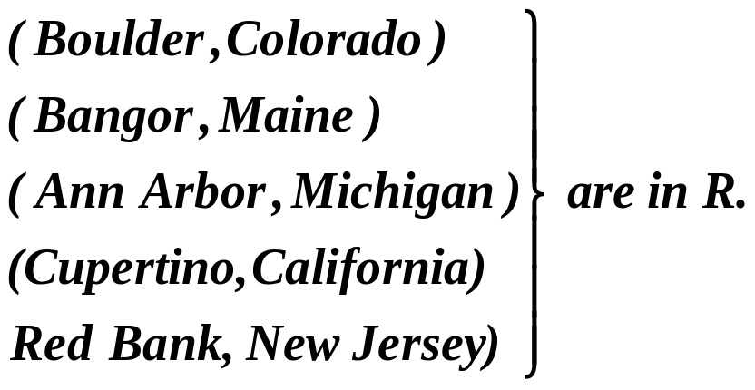
Relations (8.1) (cont.)
  Example:
  A = set of all cities
  B = set of the 50 states in the USA
  Define the relation R by specifying that (a, b) belongs to R if city a is in state b.

Slide 6
Relations (8.1) (cont.)
Functions as relations
  The graph of a function f is the set of ordered pairs (a, b) such that b = f(a)
  The graph of f is a subset of A * B ⇒ it is a relation from A to B
  Conversely, if R is a relation from A to B such that every element in A is the first element of exactly one ordered pair of R, then a function can be defined with R as its graph

Slide 7
Relations (8.1) (cont.)
Relations on a set
  Definition 2
  A relation on the set A is a relation from A to A.
  Example: A = set {1, 2, 3, 4}. Which ordered pairs are in the relation R = {(a, b) | a divides b}
  Solution: Since (a, b) is in R if and only if a and b are positive integers not exceeding 4 such that a divides b
  R = {(1,1), (1,2), (1.3), (1.4), (2,2), (2,4), (3,3), (4,4)}

Slide 8
Relations (8.1) (cont.)
Properties of Relations
  Definition 3
  A relation R on a set A is called reflexive if
  (a, a) ∈ R for every element a ∈ A.

Slide 9
Relations (8.1) (cont.)
  Example (a): Consider the following relations on {1, 2, 3, 4}
  R₁ = {(1,1), (1,2), (2,1), (2,2), (3,4), (4,1), (4,4)}
  R₂ = {(1,1), (1,2), (2,1)}
  R₃ = {(1,1), (1,2), (1,4), (2,1), (2,2), (3,3), (3,4), (4,1), (4,4)}
  R₄ = {(2,1), (3,1), (3,2), (4,1), (4,2), (4,3)}
  R₅ = {(1,1), (1,2), (1,3), (1,4), (2,2), (2,3), (2,4), (3,3), (3,4), (4,4)}
  R₆ = {(3,4)}
  Which of these relations are reflexive?

Slide 10
Relations (8.1) (cont.)
  Solution:
  R₃ and R₅: reflexive ⇐ both contain all pairs of the form (a, a): (1,1), (2,2), (3,3) & (4,4).
  R₁, R₂, R₄ and R₆: not reflexive ⇐ not contain all of these ordered pairs. (3,3) is not in any of these relations.
R₁ = {(1,1), (1,2), (2,1), (2,2), (3,4), (4,1), (4,4)} R₂ = {(1,1), (1,2), (2,1)} R₃ = {(1,1), (1,2), (1,4), (2,1), (2,2), (3,3), (3,4), (4,1), (4,4)} R₄ = {(2,1), (3,1), (3,2), (4,1), (4,2), (4,3)} R₅ = {(1,1), (1,2), (1,3), (1,4), (2,2), (2,3), (2,4), (3,3), (3,4), (4,4)} R₆ = {(3,4)}

Slide 11
Relations (8.1) (cont.)
  Definition 4:
  A relation R on a set A is called symmetric if (b, a) ∈ R whenever (a, b) ∈ R, for all a,
  b ∈ A.
  A relation R on a set A such that (a, b) ∈ R and (b, a) ∈ R only if a = b, for all a, b ∈ A, is called antisymmetric.

Slide 12
Relations (8.1) (cont.)
  Example: Which of the relations from example (a) are symmetric and which are antisymmetric?
  Solution:
  R₂ & R₃: symmetric ⇐ each case (b, a) belongs to the relation whenever (a, b) does.
  For R₂: only thing to check that both (1,2) & (2,1) belong to the relation
  For R₃: it is necessary to check that both (1,2) & (2,1) belong to the relation.
  None of the other relations is symmetric: find a pair (a, b) so that it is in the relation but (b, a) is not.
R₁ = {(1,1), (1,2), (2,1), (2,2), (3,4), (4,1), (4,4)} R₂ = {(1,1), (1,2), (2,1)} R₃ = {(1,1), (1,2), (1,4), (2,1), (2,2), (3,3), (4,1), (4,4)} R₄ = {(2,1), (3,1), (3,2), (4,1), (4,2), (4,3)} R₅ = {(1,1), (1,2), (1,3), (1,4), (2,2), (2,3), (2,4), (3,3), (3,4), (4,4)} R₆ = {(3,4)}

Slide 13
Relations (8.1) (cont.)
  Solution (cont.):
  R₄, R₅ and R₆: antisymmetric ⇐for each of these relations there is no pair of elements a and b with
  a ≠ b such that both (a, b) and (b, a) belong to the relation.
  None of the other relations is antisymmetric.: find a pair (a, b) with a ≠ b so that (a, b) and (b, a) are both in the relation.
R₁ = {(1,1), (1,2), (2,1), (2,2), (3,4), (4,1), (4,4)} R₂ = {(1,1), (1,2), (2,1)} R₃ = {(1,1), (1,2), (1,4), (2,1), (2,2), (3,3), (3,4), (4,1), (4,4)} R₄ = {(2,1), (3,1), (3,2), (4,1), (4,2), (4,3)} R₅ = {(1,1), (1,2), (1,3), (1,4), (2,2), (2,3), (2,4), (3,3), (3,4), (4,4)} R₆ = {(3,4)}

Slide 14
Relations (8.1) (cont.)
  Definition 5:
  A relation R on a set A is called transitive if whenever (a, b) ∈ R and (b,c) ∈ R, then
  (a, c) ∈ R, for all a, b, c ∈ R.

Slide 15
Relations (8.1) (cont.)
  Example: Which of the relations in example (a) are transitive?
  R₄ , R₅ & R₆ : transitive ⇐ verify that if (a, b) and (b, c) belong to this relation then (a, c) belongs also to the relation
  R₄ transitive since (3,2) and (2,1), (4,2) and (2,1), (4,3) and (3,1), and (4,3) and (3,2) are the only such sets of pairs, and (3,1) , (4,1) and (4,2) belong to R₄.
  Same reasoning for R₅ and R₆.
  R₁ : not transitive ⇐ (3,4) and (4,1) belong to R₁, but (3,1) does not.
  R₂ : not transitive ⇐ (2,1) and (1,2) belong to R₂, but (2,2) does not.
  R₃ : not transitive ⇐ (4,1) and (1,2) belong to R₃, but (4,2) does not.
R₁ = {(1,1), (1,2), (2,1), (2,2), (3,4), (4,1), (4,4)} R₂ = {(1,1), (1,2), (2,1)} R₃ = {(1,1), (1,2), (1,4), (2,1), (2,2), (3,3), (3,4), (4,1), (4,4)} R₄ = {(2,1), (3,1), (3,2), (4,1), (4,2), (4,3)} R₅ = {(1,1), (1,2), (1,3), (1,4), (2,2), (2,3), (2,4), (3,3), (3,4), (4,4)} R₆ = {(3,4)}

Slide 16
Relations (8.1) (cont.)
Combining relations
  Example:
  Let A = {1, 2, 3} and B = {1, 2, 3, 4, }. The relations R₁ = {(1,1), (2,2), (3,3)} and
  R₂ = {(1,1), (1,2), (1,3), (1,4)} can be combined to obtain:
    R₁ ∪ R₂ = {(1,1), (1,2), (1,3), (1,4), (2,2), (3,3)}
    R₁ ∩ R₂ = {(1,1)}
    R₁ – R₂ = {(2,2), (3,3)}
    R₂ – R₁ = {(1,2), (1,3), (1,4)}

Slide 17
Relations (8.1) (cont.)
  Definition 6:
  Let R be a relation from a set A to a set B and S a relation from B to a set C.
  The composite of R and S is the relation consisting of ordered pairs (a, c), where a ∈ A, c ∈ C, and for which there exists an element b ∈ B such that (a, b) ∈ R and (b, c) ∈ S. We denote the composite of R and S by S ° R.

Slide 18
Relations (8.1) (cont.)
  Example: What is the composite of the relations R and S where R is the relation from {1,2,3} to {1,2,3,4} with R = {(1,1), (1,4), (2,3), (3,1), (3,4)} and S is the relation from {1,2,3,4} to {0,1,2} with S = {(1,0), (2,0), (3,1), (3,2), (4,1)}?
  Solution: S ° R is constructed using all ordered pairs in R and ordered pairs in S, where the second element of the ordered in R agrees with the first element of the ordered pair in S.
  For example, the ordered pairs (2,3) in R and (3,1) in S produce the ordered pair (2,1) in S ° R. Computing all the ordered pairs in the composite, we find
  S ° R = ((1,0), (1,1), (2,1), (2,2), (3,0), (3,1)}

Slide 19
N-ary Relations & their Applications (8.2)
Relationship among elements of more than 2 sets often arise: n-ary relations
Airline, flight number, starting point, destination, departure time, arrival time

Slide 20
N-ary Relations & their Applications (8.2) (cont.)
N-ary relations
  Definition 1:
  Let A₁, A₂, …, A_{n} be sets. An n-ary relation on these sets is a subset of A₁ * A₂ *…* A_{n} where A_{i} are the domains of the relation, and n is called its degree.
  Example: Let R be the relation on N * N * N consisting of triples (a, b, c) where a, b, and c are integers with a<b<c. Then (1,2,3) ∈ R, but
  (2,4,3) ∉ R. The degree of this relation is 3. Its domains are equal to the set of integers.

Slide 21
N-ary Relations & their Applications (8.2) (cont.)
Databases & Relations
  Relational database model has been developed for information processing
  A database consists of records, which are n-tuples made up of fields
  The fields contains information such as:
    Name
    Student #
    Major
    Grade point average of the student

Slide 22
N-ary Relations & their Applications (8.2) (cont.)
  The relational database model represents a database of records or n-ary relation
  The relation is R(Student-Name, Id-number, Major, GPA)

Slide 23
N-ary Relations & their Applications (8.2) (cont.)
  Example of records
  (Smith, 3214, Mathematics, 3.9)
  (Stevens, 1412, Computer Science, 4.0)
  (Rao, 6633, Physics, 3.5)
  (Adams, 1320, Biology, 3.0)
  (Lee, 1030, Computer Science, 3.7)

Slide 24
N-ary Relations & their Applications (8.2) (cont.)
TABLE A: Students
Students Names | ID # | Major | GPA
Smith Stevens Rao Adams Lee | 3214 1412 6633 1320 1030 | Mathematics Computer Science Physics Biology Computer Science | 3.9 4.0 3.5 3.0 3.7

Slide 25
N-ary Relations & their Applications (8.2) (cont.)
Operations on n-ary relations
  There are varieties of operations that are applied on n-ary relations in order to create new relations that answer eventual queries of a database
  Definition 2:
  Let R be an n-ary relation and C a condition that elements in R may satisfy. Then the selection operator s_{C} maps n-ary relation R to the n-ary relation of all n-tuples from R that satisfy the condition C.

Slide 26
N-ary Relations & their Applications (8.2) (cont.)
  Example:
  if s_{C} = “Major = “computer science” ∧ GPA > 3.5” then the result of this selection consists of the 2 four-tuples:
  (Stevens, 1412, Computer Science, 4.0)
  (Lee, 1030, Computer Science, 3.7)

Slide 27
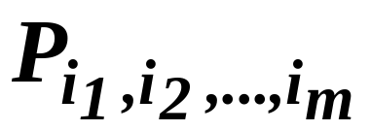
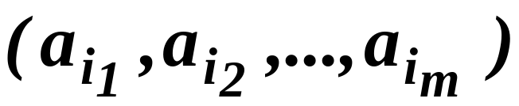
N-ary Relations & their Applications (8.2) (cont.)
  Definition 3:
  The projection maps the n-tuple (a₁, a₂, …, a_{n}) to the m-tuple
  where m ≤ n.
  In other words, the projection deletes n – m of the components of n-tuple, leaving the i₁th, i₂th, …, and i_{m}th components.

Slide 28
N-ary Relations & their Applications (8.2) (cont.)
  Example: What relation results when the projection P_{1,4} is applied to the relation in Table A?
  Solution: When the projection P_{1,4} is used, the second and third columns of the table are deleted, and pairs representing student names and GPA are obtained. Table B displays the results of this projection.
Students Names | GPA
Smith Stevens Rao Adams Lee | 3.9 4.0 3.5 3.0 3.7
TABLE B:
GPAs

Slide 29
N-ary Relations & their Applications (8.2) (cont.)
  Definition 4:
  Let R be a relation of degree m and S a relation of degree n. The join J_{p}(R,S), where p ≤ m and p ≤ n, is a relation of degree
  m + n – p that consists of all (m + n – p)-tuples (a₁, a₂, …, a_{m-p}, c₁, c₂, …, c_{p}, b₁, b₂, …, b_{n-p}), where the m-tuple (a₁, a₂, …, a_{m-p}, c₁, c₂, …, c_{p}) belongs to R and the n-tuple (c₁, c₂, …, c_{p}, b₁, b₂, …, b_{n-p}) belongs to S.

Slide 30
N-ary Relations & their Applications (8.2) (cont.)
  Example: What relation results when the operator J₂ is used to combine the relation displayed in tables C and D?

Slide 31
Professor | Dpt | Course #
Cruz Cruz Farber Farber Grammer Grammer Rosen Rosen | Zoology Zoology Psychology Psychology Physics Physics Computer Science Mathematics | 335 412 501 617 544 551 518 575
TABLE C:
Teaching
Assignments
Dpt | Course # | Room | Time
Computer Science Mathematics Mathematics Physics Psychology Psychology Zoology Zoology | 518 575 611 544 501 617 335 412 | N521 N502 N521 B505 A100 A110 A100 A100 | 2:00 PM 3:00 PM 4:00 PM 4:00 PM 3:00 PM 11:00 AM 9:00 AM 8:00 AM
TABLE D:
Class
Schedule

Slide 32
N-ary Relations & their Applications (8.2) (cont.)
  Solution: The join J₂ produces the relation shown in Table E
Professor | Dpt | Course # | Room | Time
Cruz Cruz Farber Farber Grammer Rosen Rosen | Zoology Zoology Psychology Psychology Physics Computer Science Mathematics | 335 412 501 617 544 518 575 | A100 A100 A100 A110 B505 N521 N502 | 9:00 AM 8:00 AM 3:00 PM 11:00 AM 4:00 PM 2:00 PM 3:00 PM
Table E:
Teaching
Schedule

Slide 33
N-ary Relations & their Applications (8.2) (cont.)
  Example: We will illustrate how SQL (Structured Query Language) is used to express queries by showing how SQL can be employed to make a query about airline flights using Table F. The SQL statements
      SELECT departure_time
      FROM Flights
      WHERE destination = ‘Detroit’
  are used to find the projection P₅ (on the departure_time attribute) of the selection of 5-tuples in the flights database that satisfy the condition: destination = ‘Detroit’. The output would be a list containing the times of flights that have Detroit as their destination, namely, 08:10, 08:47, and 9:44.

Slide 34
N-ary Relations & their Applications (8.2) (cont.)
Table F: Flights
Airline | Flight # | Gate | Destination | Departure time
Nadir Acme Acme Acme Nadir Acme Nadir | 122 221 122 323 199 222 322 | 34 22 33 34 13 22 34 | Detroit Denver Anchorage Honolulu Detroit Denver Detroit | 08:10 08:17 08:22 08:30 08”47 09:10 09:44

Slide 35
Representing Relations (8.3)
First way is to list the ordered pairs
Second way is through matrices
Third way is through direct graphs

Slide 36
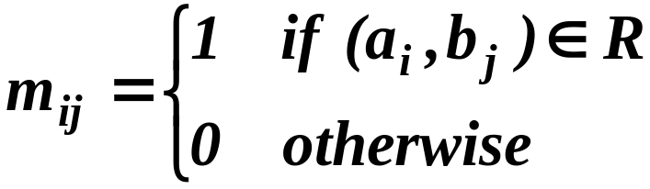
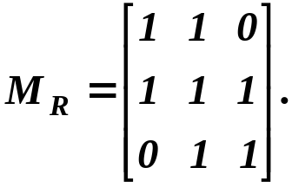
Representing Relations (8.3)
Representing relations through matrices
  Example: Suppose that the relation R on a set is represented by the matrix:
  Is R reflexive, symmetric, and/or antisymmetric?
  Solution: Since all the diagonal elements of this matrix are equal to 1, R is reflexive. Moreover, since M_{R} is symmetric ⇒ R is symmetric. R is not antisymmetric.

Slide 37
Representing Relations (8.3)
Representing relations using diagraphs
  Definition 1:
  A directed graph, or diagraph, consists of a set V of vertices (or nodes) together with a set E of ordered pairs of elements of V called edges (or arcs). The vertex a is called the initial vertex of the edge (a, b), and the vertex b is called the terminal vertex of this edge.

Slide 38
Representing Relations (8.3)
  Example: The directed graph with vertices a, b, c and d , and edges (a,b), (a,d), (b,b), (b,d), (c,a) and (d,b). The edge (b,b) is called a loop.
a
b
d
c

Slide 39
Equivalence Relations (8.5)
Students registration time with respect to the first letter of their names
R contains (x,y) ⇔ x and y are students with last names beginning with letters in the same block
3 blocks are considered: A-F, G-O, P-Z
R is reflexive, symmetric & transitive
The set of student is therefore divided in 3 classes depending on the first letter of their names

Slide 40
Equivalence Relations (8.5)
Definition 1
A relation on a set A is called an equivalence relation if it is reflexive, symmetric and transitive.
Examples
:
  Suppose that R is the relation on the set of strings of English letters such that aRb if and only if l(a) = l(b), where l(x) is the length of the string x. Is R an equivalence relation?
  Solution: R is reflexive, symmetric and transitive ⇒ R is an equivalence relation
  A divides b; is it an equivalence relation?

Slide 41
Equivalence Relations (8.5)
Equivalence classes
  Definition 2:
  Let R be an equivalence relation on a set A. The set of all elements that are related to an element a of A is called the equivalence class of a. The equivalence class of a with respect to R is denoted by [a]_{R}. When only one relation is under consideration, we will delete the subscript R and write [a] for this equivalence class.

Slide 42
Equivalence Relations (8.5)
  Example: What are the equivalences classes of 0 and 1 for congruence modulo 4?
  Solution:
  The equivalence class of 0 contains all the integers a such that a ≡ 0 (mod 4). Hence, the equivalence class of 0 for this relation is
  [0] = {…, -8, -4, 0, 4, 8, …}
  The equivalence class of 1 contains all the integers a such that a ≡ 1 (mod 4). The integers in this class are those that have a remainder of 1 when divided by 4. Hence, the equivalence class of 1 for this relation is
  [1] = {…, -7, -3, 1, 5, 9, …}

Slide 43
Equivalence Relations (8.5)
Equivalence classes & partitions
  Theorem 1:
  Let R be an equivalence relation on a set A. These statements are equivalent:
      a R b
      [a] = [b]
      [a] ∩ [b] ≠ ∅

Slide 44
Equivalence Relations (8.5)
  Theorem 2:
  Let R be an equivalence relation on a set S. Then the equivalence classes of R form a partition of S. Conversely, given a partition
  {A_{i} | i ∈I} of the set S, there is an equivalence relation R that has the sets A_{i} , i ∈ I, as its equivalence classes.

Slide 45
Equivalence Relations (8.5)
  Example: List the ordered pairs in the equivalence relation R produced by the partition A₁ = [1,2,3},
  A₂ = {4,5} and A₃ = {6} of S = {1,2,3,4,5,6}
  Solution: The subsets in the partition are the equivalences classes of R. The pair (a,b) ∈ R if and only if a and b are in the same subset of the partition.
  The pairs (1,1), (1,2), (1,3), (2,1), (2,2), (2,3), (3,1), (3,2) and (3,3) ∈ R ⇐ A₁ = [1,2,3} is an equivalence class. The pairs (4,4), (4,5), (5,4) and (5,5) ∈ R ⇐
  A₂ = {4,5} is an equivalence class.
  The pair (6,6) ∈ R ⇐ {6} is an equivalence class.
  No pairs other than those listed belongs to R.

